Slide 1
Module 4 Dynamic Programming
Introduction to Dynamic Algorithms
All pair shortest path
0/1 knapsack
Travelling salesman problem
Matrix Chain Multiplication
Optimal binary search tree
Analysis of All algorithms and problem solving

Slide 2
Difference between Greedy and Dynamic Programming Method
Greedy method: predefined procedure to get optimal solution
Dynamic Programming: find all possible solutions and then find optimal solution.
DP problems are solved using recursive formula. Mostly solved using iterations.
DP follows principle of optimality which says that a problem can be solved by taking a sequence of decisions to get optimal solution.
In Greedy method decision is taken only once. In DP , at every stage we take decision.
DP adopts tabular and memoization methods.

Slide 3
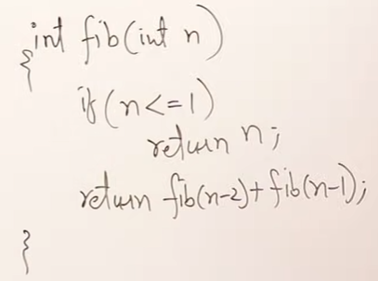
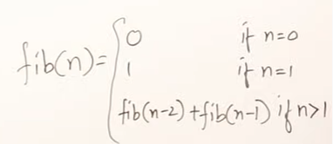
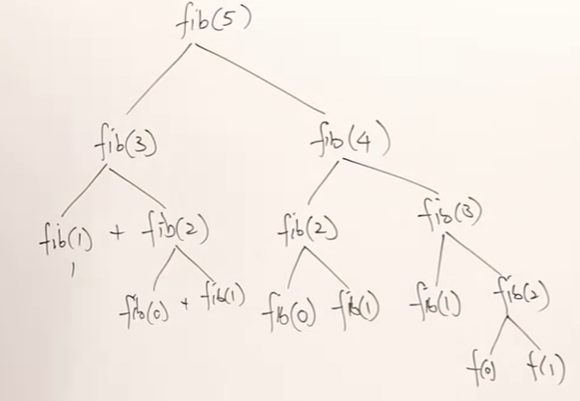
RR:
T(n)=2T(n-1) + 1 , assuming n-2=n-1
TC = O(2^{n})
Can we reduce this TC?
[2^(n-1) -1 ]Calls

Slide 4
Memoization Method
Write the recursive code
Memoize the return value and use it to reduce recursive calls.
RR:
T(n)=2T(n-1) + 1 , assuming n-2=n-1
TC = O(2^{n}) .. Using Master’s Theorem.
Can we reduce this TC?
Only 6(n+1) calls . —> O(n)
Time reduced from Exponential to linear polynomial.
F
-1 | -1 | -1 | -1 | -1 | -1
Memoization is a Top-Down approach
0 1 2 3 4 5
F
0 | 1 | 1 | 2 | 3 | 5
0 1 2 3 4 5

Slide 5
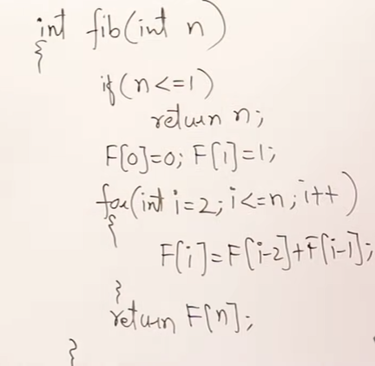
Tabulation/Iterative Method (using recursive formula)
Bottom Up approach as table is filled from smaller value first.
F
0 | 1 | 1 | 2 | 3 | 5
0 1 2 3 4 5

Slide 6
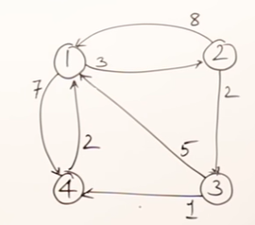
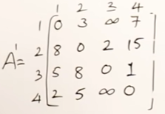
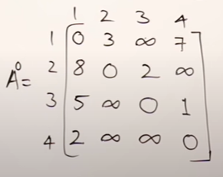
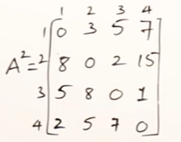
All Pairs Shortest Path (Floyd-Warshall) - Dynamic Programming method
1 as intermediate vertex
1 as intermediate vertex
2 as intermediate vertex

Slide 7
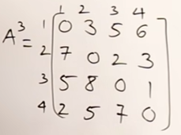
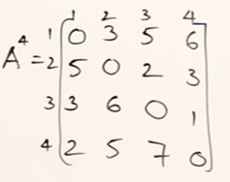
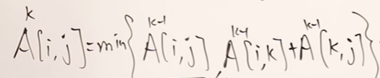
All Pairs Shortest Path (Floyd-Warshall) - Dynamic Programming
Recursive Formula:

Slide 8
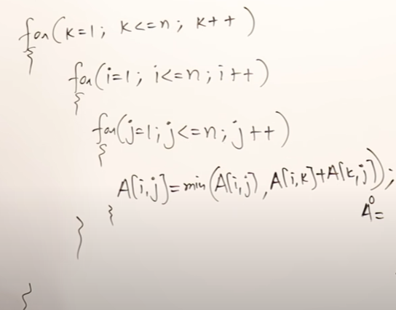
Time Complexity
All Pairs Shortest Path (Floyd-Warshall) - Dynamic Programming
Formula:
TC=O(n³)

Slide 9

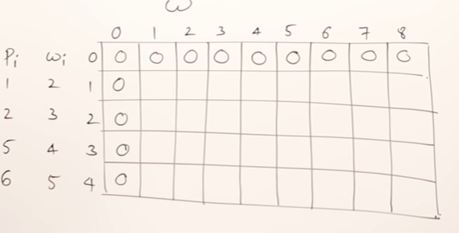
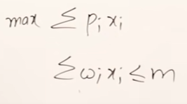
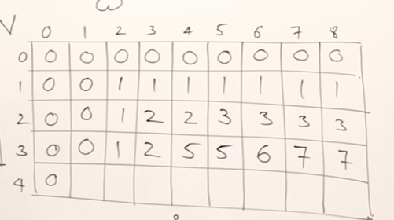


0/1 Knapsack Problem(Tabular Method)

Slide 10



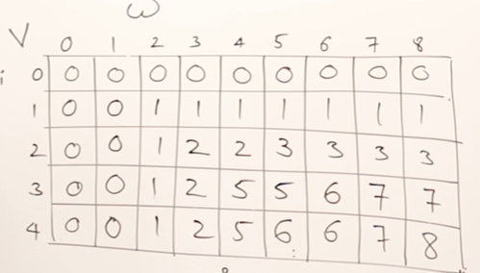


0/1 Knapsack Problem

Slide 11
How to find solution once table is created?

Slide 12
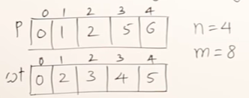
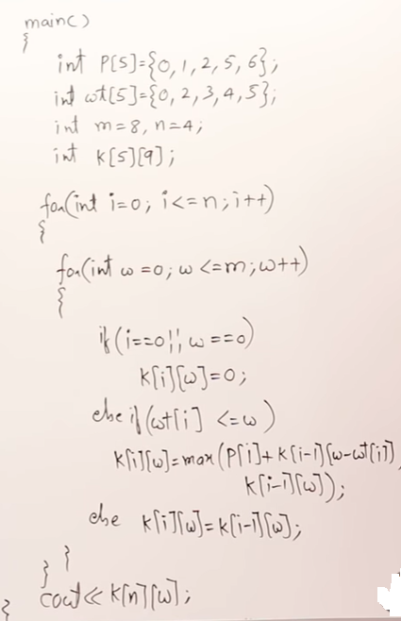
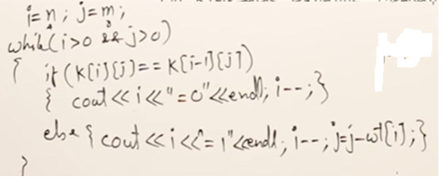
0/1 Knapsack Problem : Program and TC
TC= O(n.m)

Slide 13






















0/1 Knapsack Problem (Set Method)
Solution = (0,1,0,1)

Slide 14
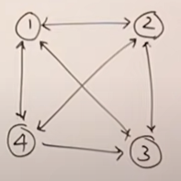
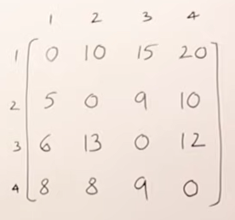


Travelling Salesman Problem: DP approach
TSP: Start from source vertex, visit all vertices once and return back to source vertex. Travel such that total cost of travelling is minimum.
General Formula:
Formula wr.t no. of vertices=4:

Slide 15
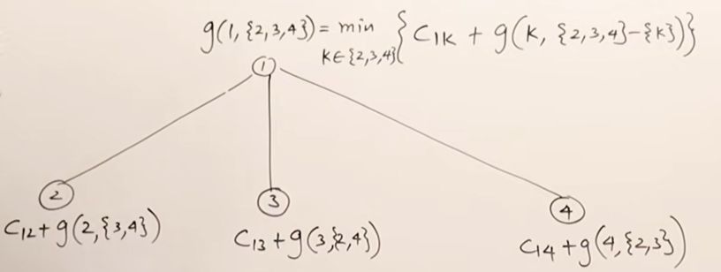
Recursion Tree

Slide 16
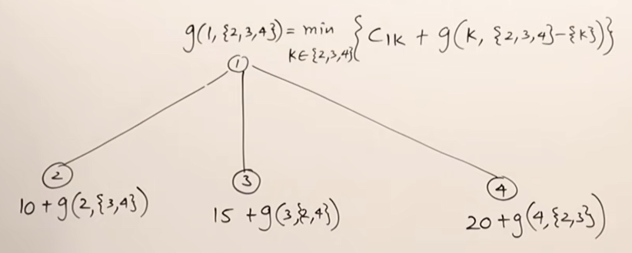
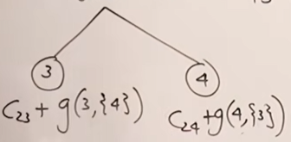
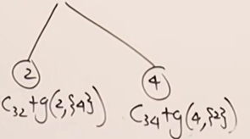
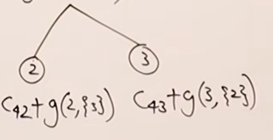

Slide 17
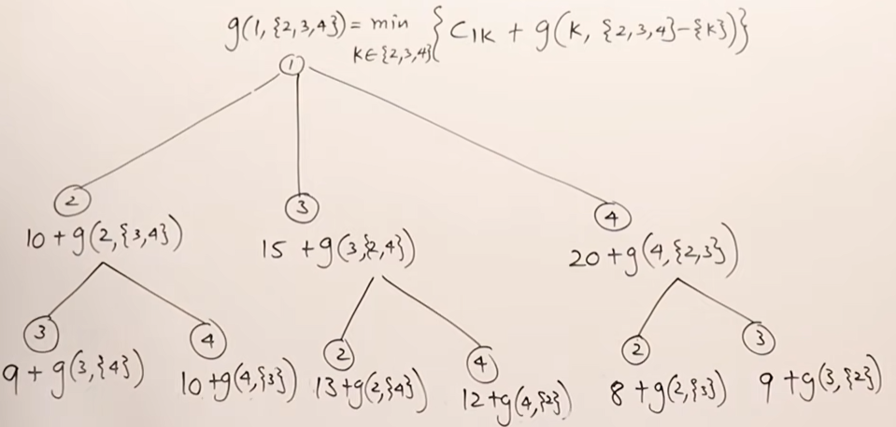
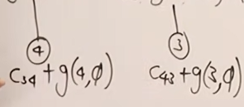


Slide 18
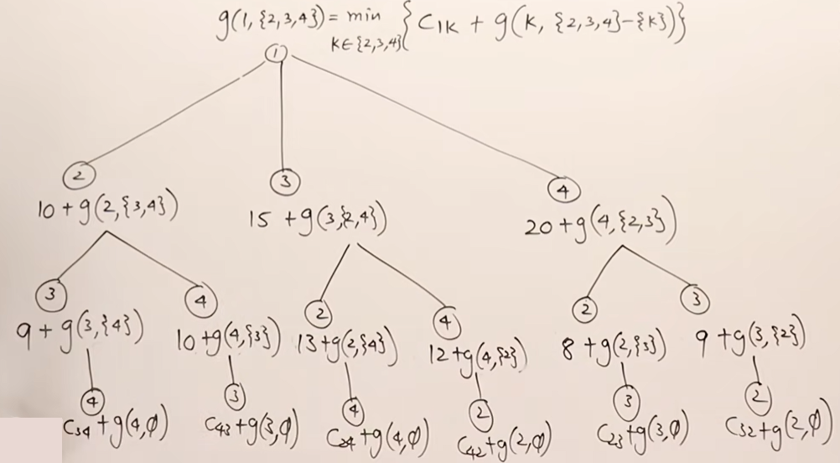

Slide 20
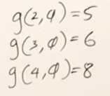
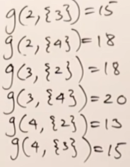
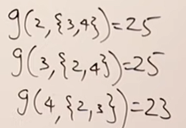

Set 1:Nothing remaining
Set 2:one vertex remaining
Set 3:Two vertices remaining
Set 4:Three vertices remaining

Slide 21


Set 1:Nothing remaining
Set 2:one vertex remaining
Set 3:Two vertices remaining
Set 4:Three vertices remaining
How to find Minimum cost path using above table: Source vertex =1
From set 4, we got minimum cost = with k=2. So salesman will visit city 2 first from source source city 1. So now salesman at vertex 2 with remaining cities to be visited as 3 and 4.
Now look at set3. Here we got for k=4 . So salesman will visit city 4 from current city 2. So now salesman at city 4 with remaining cities to be visited as 3
Now look at set2. Here we got for k=3. So salesman will visit vertex 3 from current city 4. So now salesman at vertex 3 with no remaining cities to be visited. So he will return back to source city 1.
Thus the sequence in which salesman will travel from source city 1 is 1-2-4-3-1 with the cost of 35 🡺 optimal sequence.

Slide 22
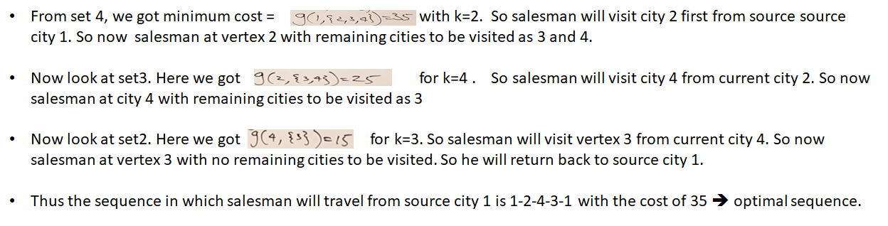
Set 1:Nothing remaining
Set 2:one vertex remaining
Set 3:Two vertices remaining
Set 4:Three vertices remaining
How to find Minimum cost path using above table: Source vertex =1
Greedy solution? 1—2---3—4—1 cost=39

Slide 23
TSP Time Complexity https://www.youtube.com/watch?v=vq_vEBlEmZY
Time complexity= O(n²2^{n})

